Slide 1
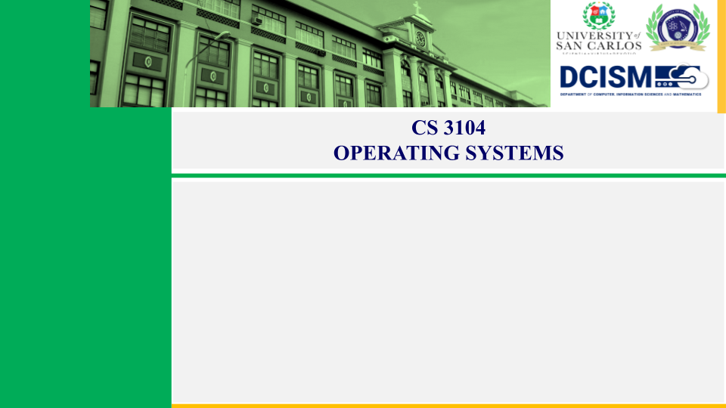
Team 2 (Team JC)
Guzman, Jastine O.
Leaño, Jomar M.
Rosales, Jade Andrie T.
Samson, Jose Glen A.
Stewart, Christian Anthony C.
History of Operating Systems
Timeline and Evolution

Slide 2
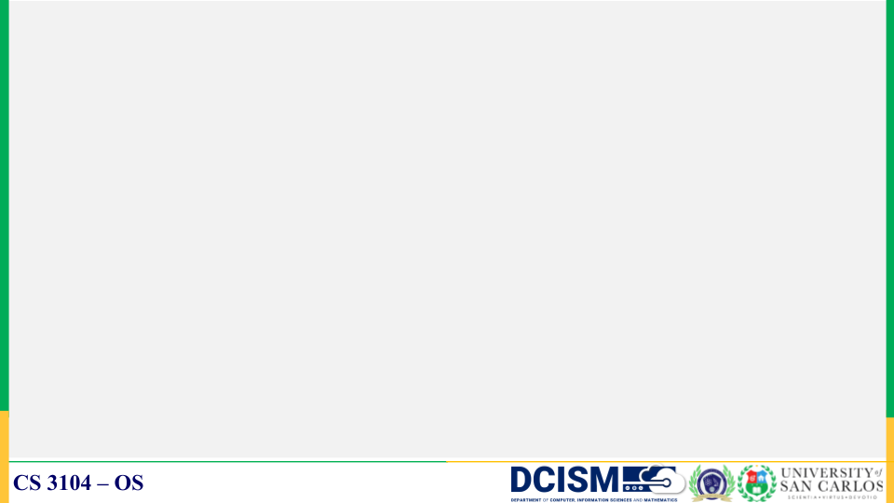
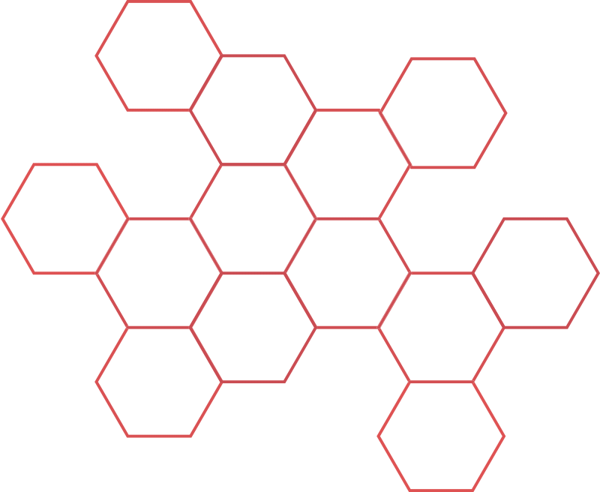
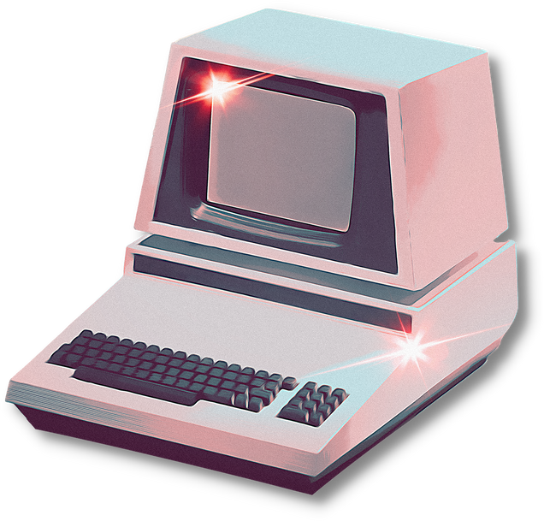
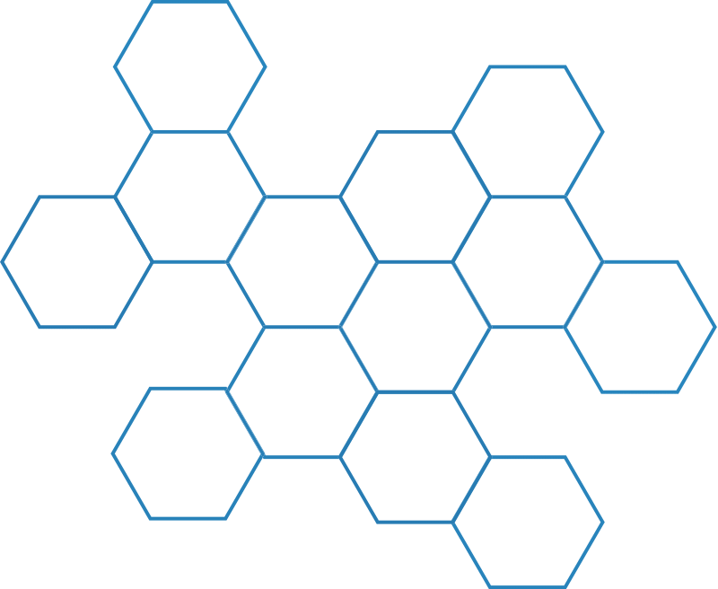
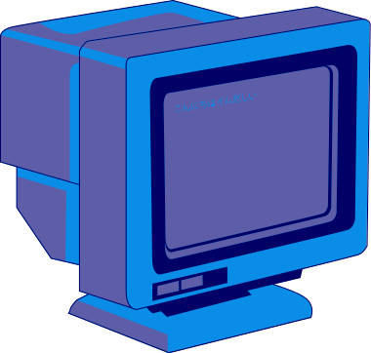
INTRODUCTION
Notes:
The most crucial piece of software that runs on a computer is the operating system. It controls the memory, operations, software, and hardware of the computer. You can converse with the computer using this method even if you don't understand its language. A computer cannot function without an operating system.
Operating systems were not present on the early computers. Each program that ran on these early computers had to have all the necessary code in order to operate on the computer, communicate with the linked hardware, and carry out the desired computation. Even the simplest programs become extremely complicated under this circumstance.

Slide 3
Operating Systems
The operating system is the most crucial software that runs on a computer. It controls the computer's memory, operations, software, and hardware. Using this method, you can converse with the computer even if you don't understand its language.
A computer cannot function without an operating system.
Notes:
In response to this problem, the owners of the central computers began to develop system software that facilitated the writing and execution of the programs included in the computer, and thus the first operating systems were born.
The proprietors of the central computers began to create system software as a solution to this issue, making it easier to create and run computer programs. As a result, the first operating systems were created.

Slide 4
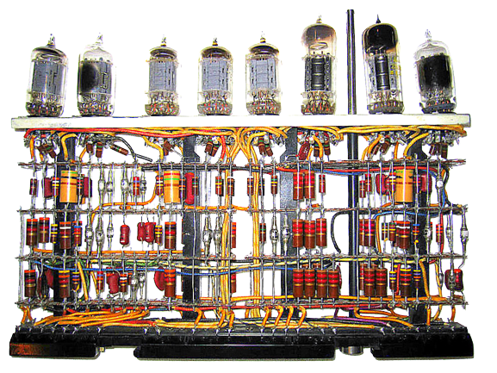
Operating systems were not present on the early computers.
Each program that ran on these early computers had to have all the necessary code to operate on the computer, communicate with the linked hardware, and carry out the desired computation. Even the most straightforward programs become extremely complicated under this circumstance.
Vacuum tube Computer
Notes:
In response to this problem, the owners of the central computers began to develop system software that facilitated the writing and execution of the programs included in the computer, and thus the first operating systems were born.
The proprietors of the central computers began to create system software as a solution to this issue, making it easier to create and run computer programs. As a result, the first operating systems were created.

Slide 5


In response to this problem, the owners of the central computers began to develop system software that facilitated the writing and execution of the programs included in the computer and thus the first operating systems were born.
Notes:
In response to this problem, the owners of the central computers began to develop system software that facilitated the writing and execution of the programs included in the computer, and thus the first operating systems were born.
The proprietors of the central computers began to create system software as a solution to this issue, making it easier to create and run computer programs. As a result, the first operating systems were created.

Slide 6


The earliest computers were mainframes that lacked any form of the operating system. Each user uses punched paper cards and magnetic or paper tape.

Slide 7
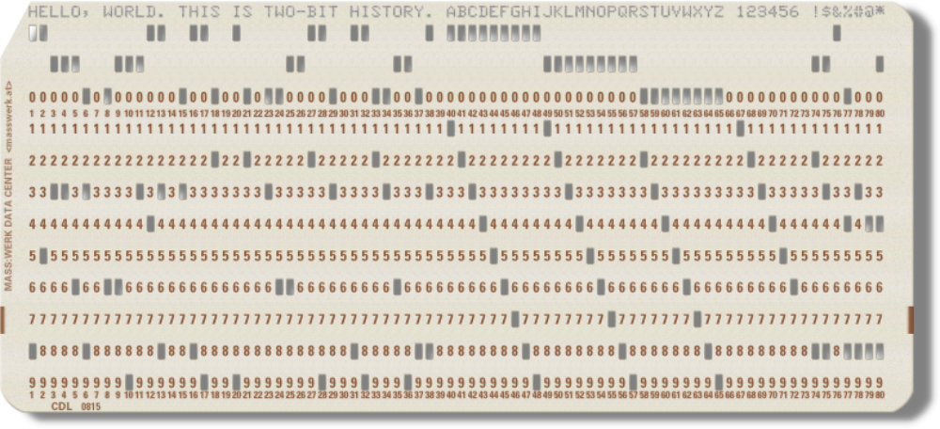
Many people were at first dubious that hole-filled cards were better than ledger books. Nonetheless, punched cards dominated data processing from the 1930s to 1960s. Clerks punched data onto cards using keypunch machines without needing computers.
Punch Paper Card
Notes:
A punch card is a piece of stiff paper that holds digital data represented by the presence or absence of holes in predefined positions. Punched cards were once common in data processing applications or to directly control automated machinery.

Slide 8
THE INFANCY OF
OPERATING SYSTEMS
(1950s)

Slide 9

1956
GMOS
Evolution of
Operating System
(1950s-1970s)
1969
Unix
1973
Xerox Alto
1978
Apple DOS

Slide 10
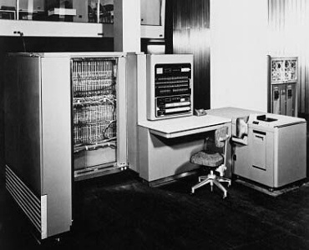
GMOS (1956)
The first operating system was introduced early in the 1950s it was referred to as the GMOS and was created by General Motors for IBM's machine the 701.
Each manufacturer had such proprietary operating systems, which differed from each other completely, and the operator had always relearn everything from scratch.
Notes:
Operating systems have evolved from slow and expensive systems to present-day technology where computing power has reached exponential speeds and relatively inexpensive costs, In the beginning back when computers were manually loaded with program code to control computer functions and process code related to business logic.
The first operating system was introduced early in the 1950 it was referred to as the GMOS and was created by General Motors for IBM's machine the 701.
Operating systems in 1950's were called single-stream batch processing systems because the data was submitted in groups.

Slide 11
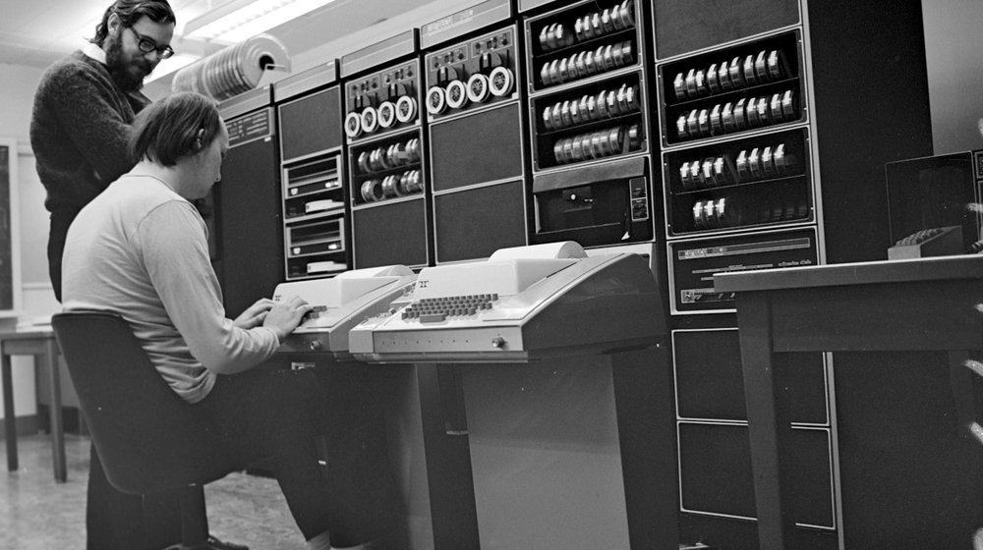
UNIX (1969)
Unix is a portable, multitasking, multiuser, time-sharing operating system (OS) originally developed in 1969 by a group of employees at AT&T.
Notes:
UNIX laid the foundation of todays operating systems which include Linux, Mac OS X, NeXTSTEP, OpenBSD
Unix was first programmed in assembly language but was reprogrammed in C in 1973

Slide 12
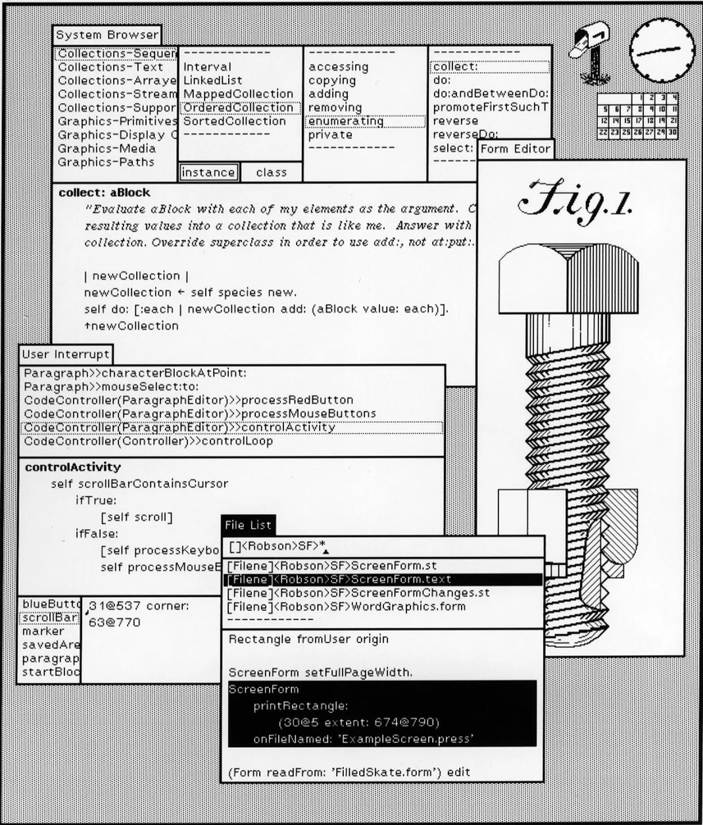
Xerox Alto (1973)
The Xerox Alo is a computer designed from its inception to support an operating system based on a graphical user interface (GUI), later using the desktop metaphor. The first machines were introduced on 1 March 1973, a decade before mass-market GUI machines became available.
Notes:
The Xerox Alto was not very commercial yet it was very successful, his success affected the entire generation of computers and operating systems. It was the first computer made that used a mouse and had a fully graphical interface

Slide 13
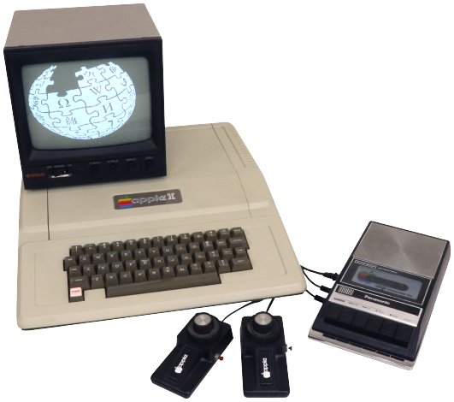
Apple DOS (1973)
Apple DOS was the first operating system for the Apple computer that was primarily developed by Paul Laughton, Randy Wigginton, and Steve Wozniak for the Apple II series of computers. The first release of Apple DOS was Apple DOS 3.1 that was released in June 1978.

Slide 14

MS DOS
1981
Evolution of
Operating System
(1980s-1990s)
NeXTSTEP
1989
Windows 3.1
1992
Windows 98
1998

Slide 15
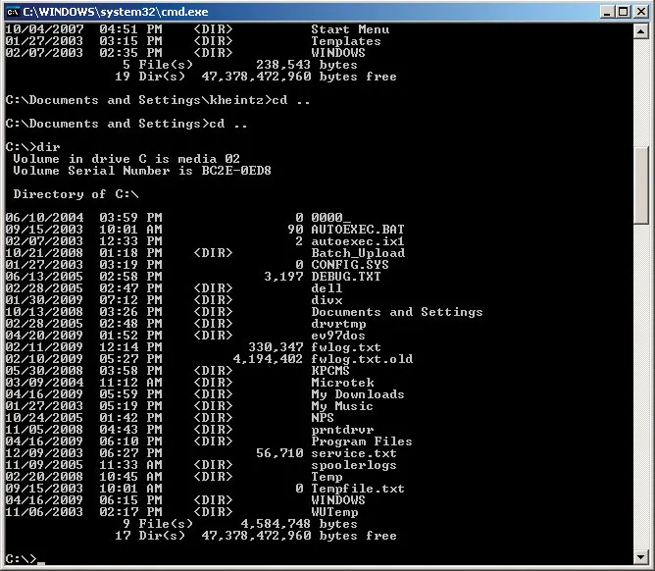
MS DOS (1981)
The MS DOS system is a service firm on behalf of Microsoft that has done a multinational corporation.

Slide 16
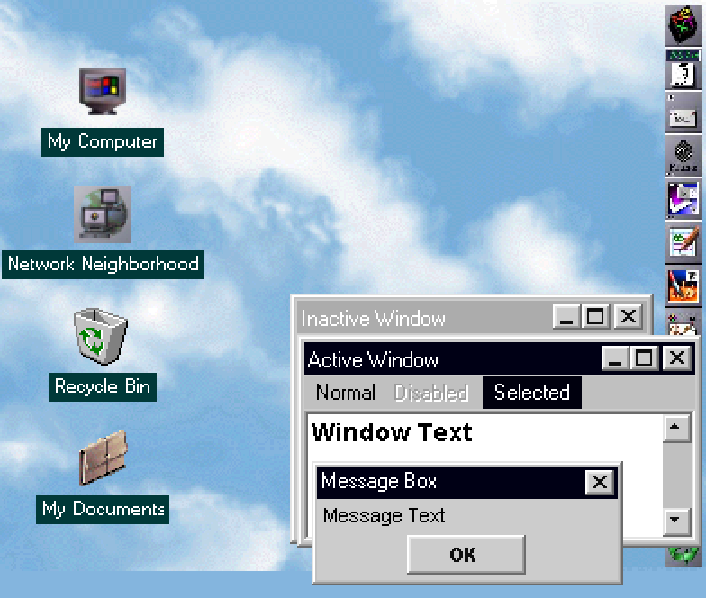
NeXTSTEP (1989)
Steve Jobs in the 80's left Apple and went to pursue his own project called NeXTSTEP which would yield Mac OS X, later called macOS.

Slide 17
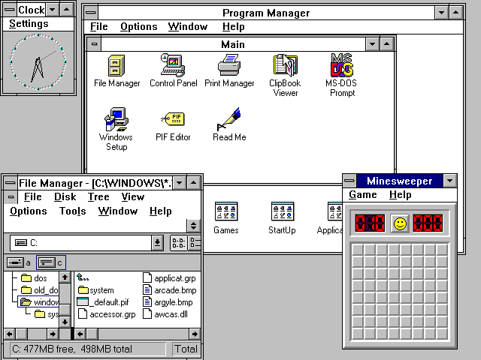
Windows 3.1
The first Window with Internet
Windows 3.1’s improvements in text rendering and multimedia—and the increased availability of Windows applications from the industry—made trips to the DOS command line less necessary.

Slide 18
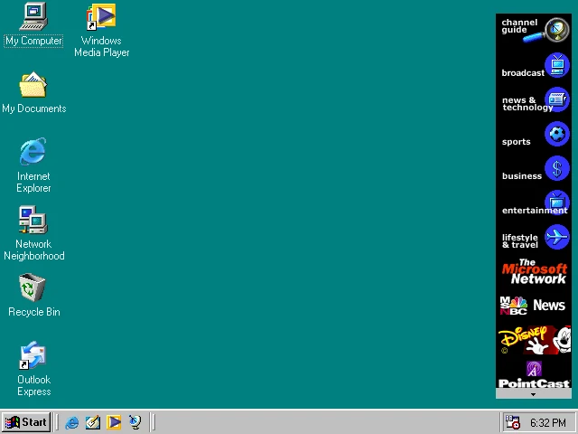
Windows 98
The operating system Windows 98 contains as innovation mainly detail improvements and bug fixes. The hardware component is enhanced with USB support improved and the operation of several monitors is possible now.

Slide 19


2001
Windows XP
Evolution of
Operating System
(2000s-2008s)
2001
Mac OS X
2007
iOS
2008
Android

Slide 20
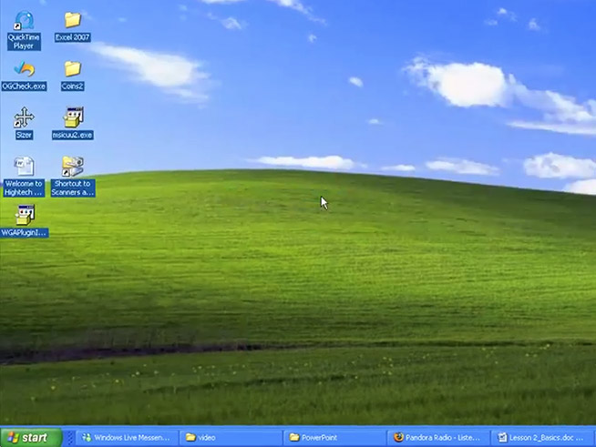
Windows XP (2001)
Windows XP is a version of Microsoft windows operating system for personal computers

Slide 21
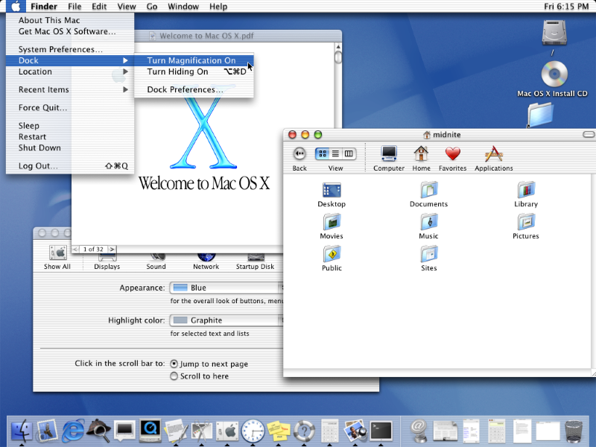
Mac OS X (2001)
MAC OS X featured Apple's brand new user interface Aqua and the first versions of apps like TextEdit, Preview, Mail, and QuickTime.
The new OS X demanded an (at that time: whopping!) 128 MB of RAM and 800 MB of disk space.

Slide 22
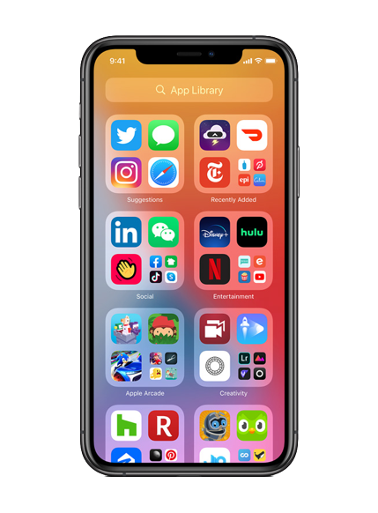
iOS (2007)
iOS is a proprietary mobile operating system that runs on mobile devices including the iPhone. It is based on the Mac OS X operating system for desktop and laptop computers.

Slide 23
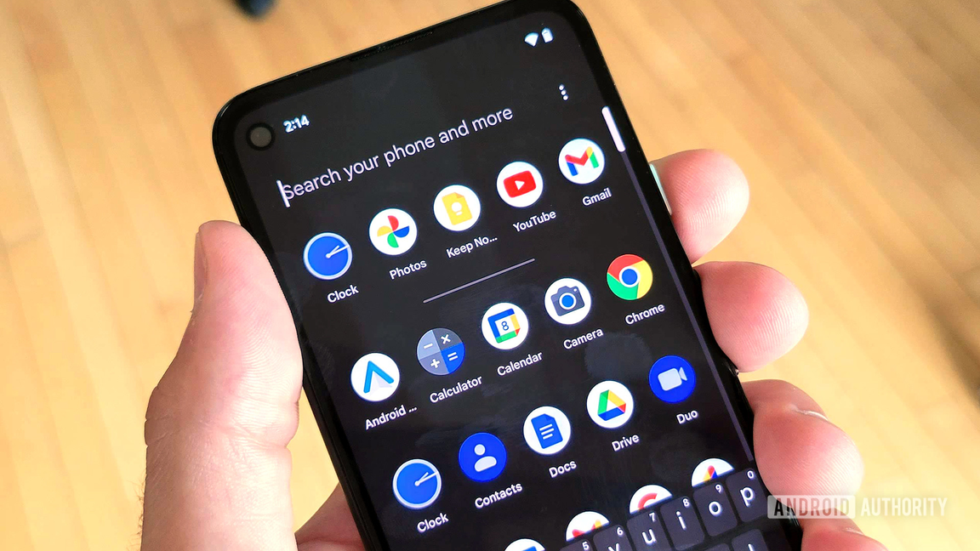
Android (2008)
Android is designed primarily for touch screens mobile devices such as smartphones and tablet computers. It is one of the most widely used mobile OS these days.

Slide 24
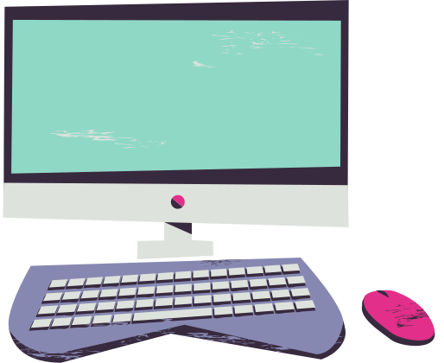
Evolution of
Operating System
(2008s-2010s)
2009
Windows 7
2010
Chrome OS

Slide 25
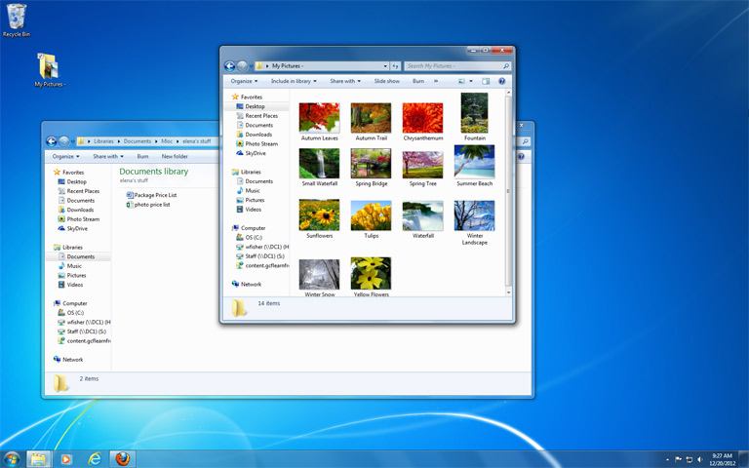
Windows 7 (2009)
Microsoft in 2009 released Windows 7, an OS whose interface was similar to that of Vista but was met with enthusiasm for its noticeable speed improvement and its modest system requirements.

Slide 26
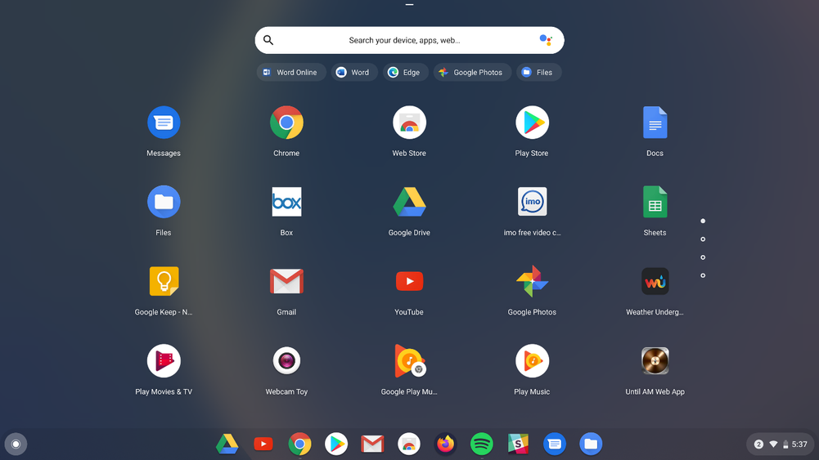
Chrome OS (2010)
The operating system is very minimalist and designed for mobile devices with a permanent internet connection

Slide 27
